Slide 1

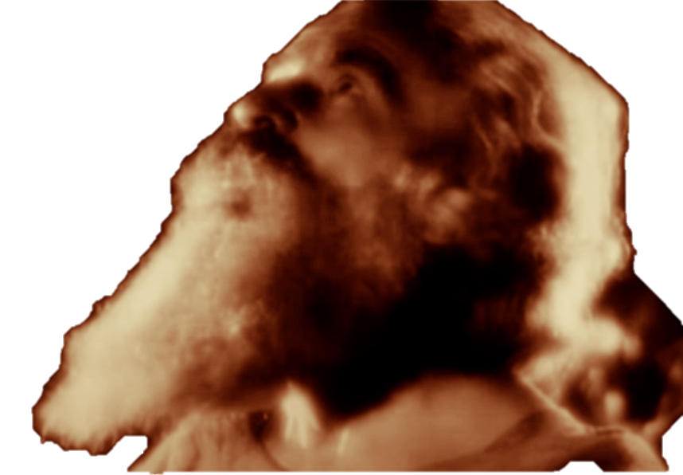



FATHER’S TIMELINE
GENERATIONS
of the world
BIBLE HISTORY, BIBLE PROPHECY, AND THE BOOK OF ENOCH

Slide 2
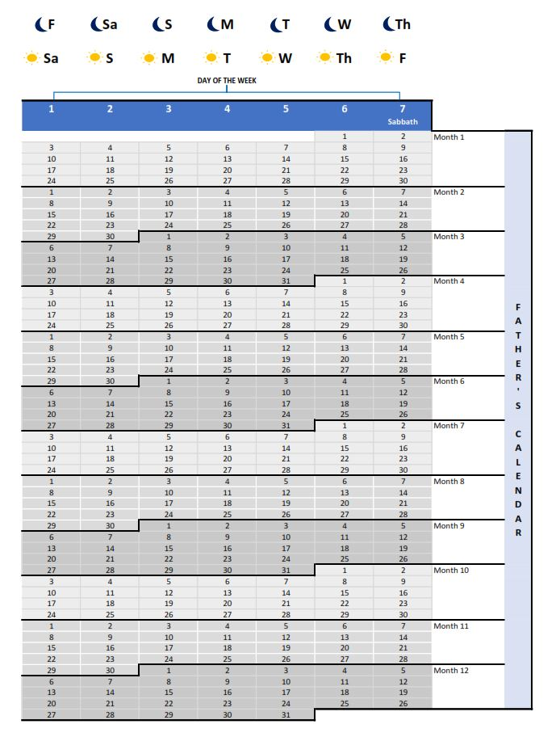
Calendar basics
364 days per year
4 seasons per year
3 months in each season
No intercalations
Sabbath is on Thursday Night
Full calendar explanation at
fathersalphabet.com/calendar
Free calendar download at
fathersalphabet.com/generations

Slide 3
September 4, 2024: Yom Teruah (Feast of Trumpets)
September 13, 2024: Yom Kippur (Day of Atonement)
September 18, 2024: Sukkot (Feast of Tabernacles)
March 5, 2025: Aviv 1
March 18, 2025: Passover
March 19, 2025: Feast of Unleavened Bread
March 21, 2025: Firstfruits
May 9, 2025: Shavuot (Pentecost)
September 3, 2025: Yom Teruah (Feast of Trumpets)
September 12, 2025: Yom Kippur (Day of Atonement)
September 17, 2025: Sukkot (Feast of Tabernacles)
UPCOMING DATES
(all dates are after sundown)

Slide 4
“in the days of the sinners… the fruits of the earth will be late and not grow at their proper time”
– 1 Enoch 80
First day
of Harvest
364 day year
First day
of Harvest
364 day year
First day
of Harvest
364 day year
First day
of Harvest
365.2422 day year
First day
of Harvest
365.2422 day year
365.2422 day year
First day
of Harvest

Slide 5
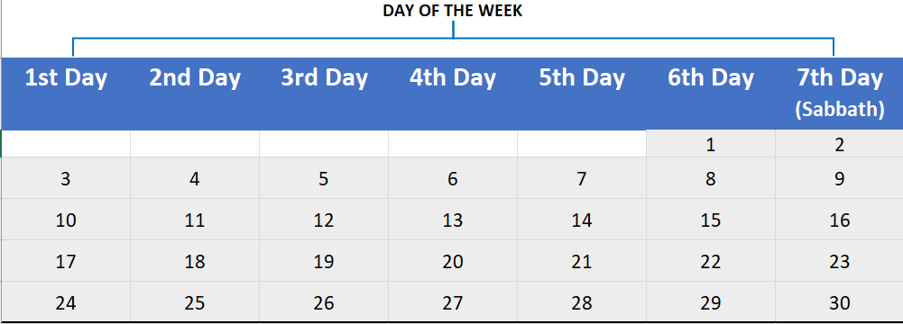
“In those days I Daniel was mourning three full weeks. I ate no pleasant bread, neither came flesh nor wine in my mouth, neither did I anoint myself at all, till three whole weeks were fulfilled. And in the four and twentieth day of the first month, as I was by the side of the great river...”
- Daniel 10:2-4
3 FULL
WEEKS

Slide 6

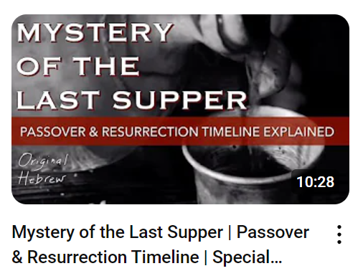
YASHUA’s Resurrection was on
the first day of the week, on Aviv 17.

Slide 7
scriptures that indicate a day starts at sundown
Leviticus 23:32
Exodus 12:18
John 20:1
Luke 23:54
Enoch 72:25-27
“And the sun… sets in the first portal in the west of the heaven…. And the sun has therewith traversed the divisions of his orbit.”
- 1 Enoch 72

Slide 8
ENOCH’S PORTALS

Slide 9
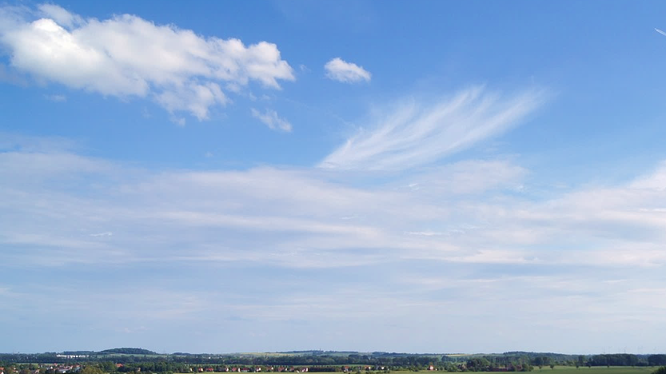

The Sun’s Path Through the Sky
Facing the Southern Sky

Slide 10
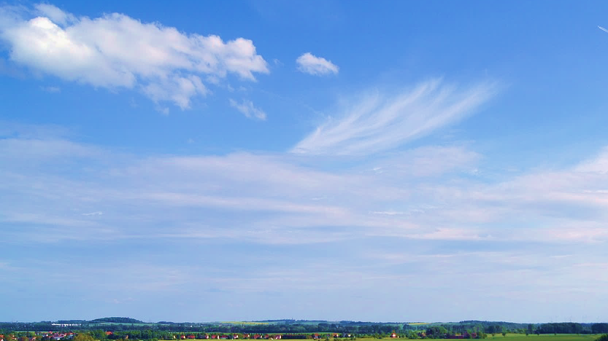
The Sun’s Path Through the Sky
Spring & Summer Months
Winter & Fall Months
Facing the Southern Sky
2
1
1
2
4
5
6
6
5
4
3
3
Eastern Portals
Eastern Gates
Western Gates
Western Portals

Slide 11
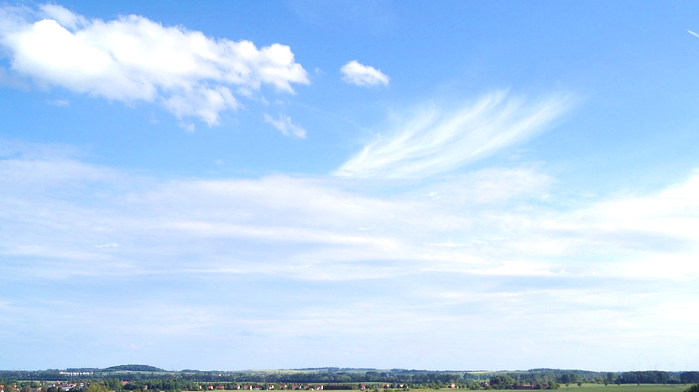
The Sun’s Path Through the Sky
In Spring & Summer Months
Facing the Southern Sky
6
5
4
4
5
6
Eastern Portals
Western Portals

Slide 12
The Sun’s Path Through the Sky
In Fall & Winter Months
Facing the Southern Sky
2
1
1
2
3
3
Eastern Gates
Eastern Portals
Western Portals
Western Gates

Slide 13
The Sun’s Path Through the Sky
Spring & Summer Months
Winter & Fall Months
Facing the Southern Sky
2
1
1
2
4
5
6
6
5
4
3
3
Eastern Gates
Eastern Portals
Western Portals
Western Gates

Slide 14
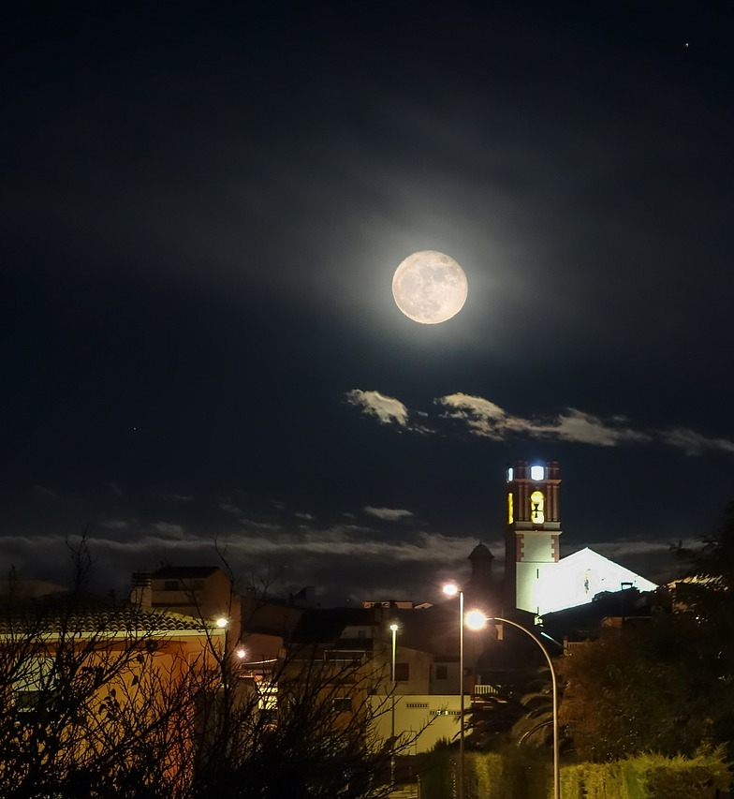
Modern Jewish Calendar
Earliest use unknown
Formally adopted 4th century AD
Derived in part from the ancient Babylonian calendar
Lunar, based on moon phases
354 or 384 days per year, on average
13th month intercalations

Slide 15
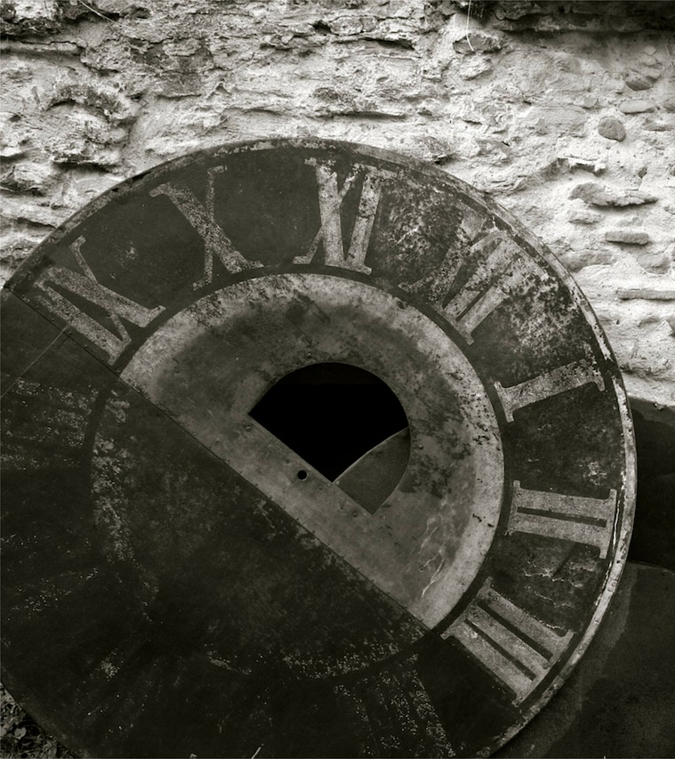
EVIDENCE AGAINST a 13th MONTH
1 Chronicles 27
1 Kings 4:7-19
Revelation 22:2
Enoch 82:11

Slide 16
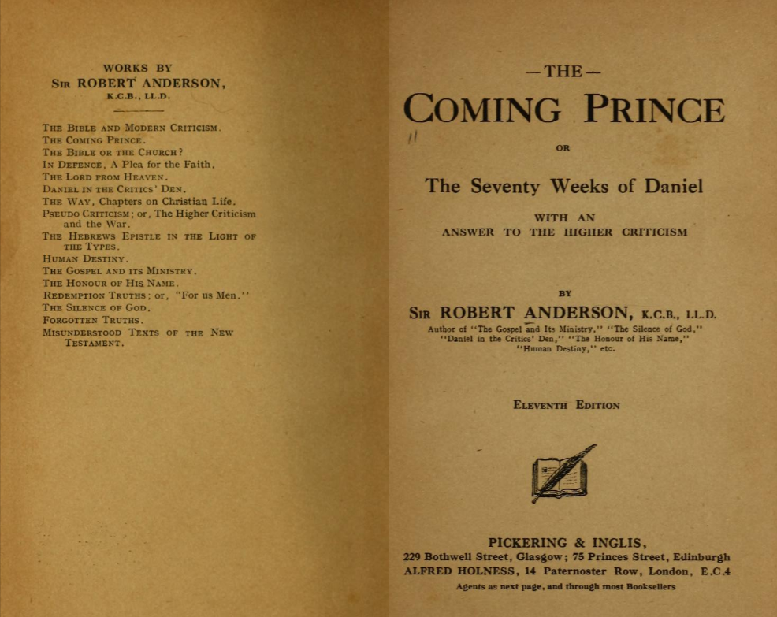
360 Day “Prophetic Year”
Favored by many Bible scholars and teachers
Popularized by Sir Robert Anderson’s 19th century book “The Coming Prince”
No Biblical basis

Slide 17
360 Day “Prophetic Year”
“If tradition may be trusted, Abraham preserved in his family the year of 360 days which he had known in his Chaldean home.”
150 days is “specified as the interval between the 17th day of the 2nd month and the same day of the 7th month”
One half of seven years is “described… twice as 1260 days” in Revelation

Slide 18
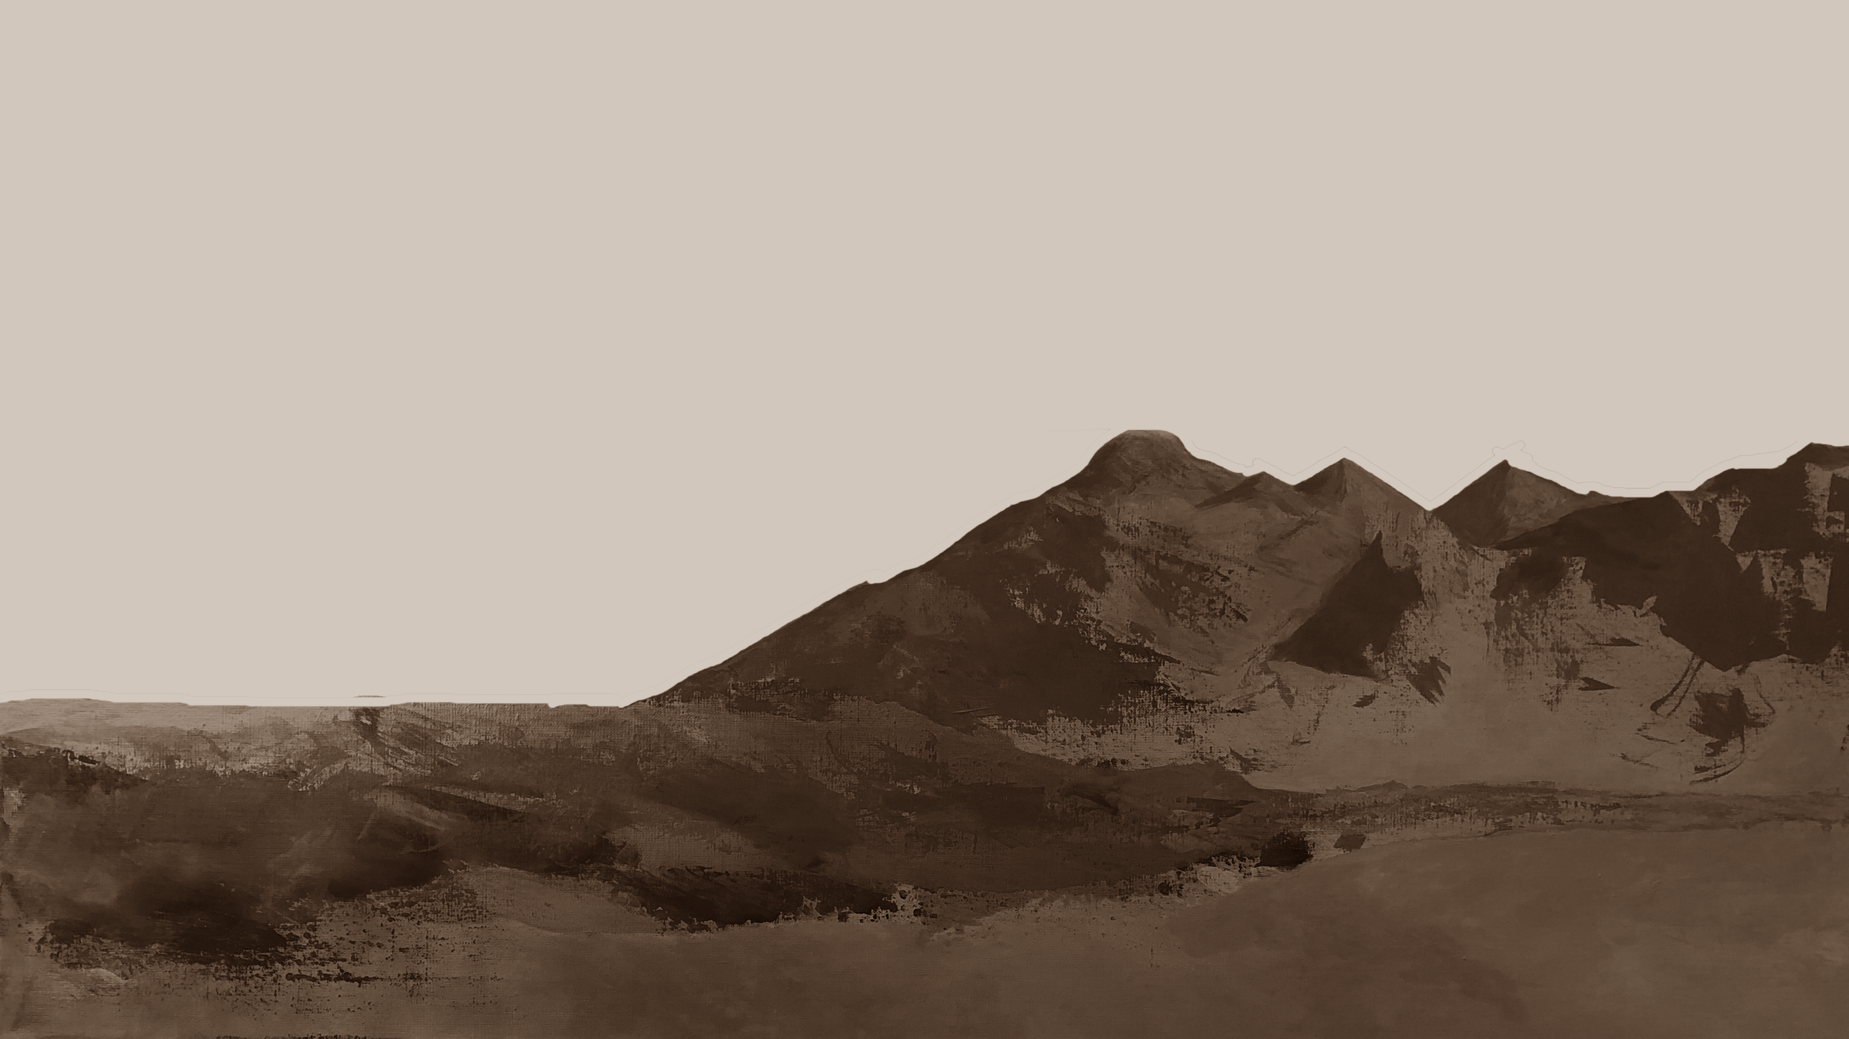
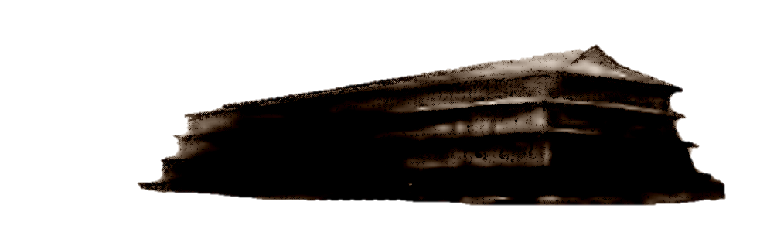


Slide 20
The Flood began on 2/17 (Genesis 7:11)

Slide 21
The Flood began on 2/17 (Genesis 7:11)
The waters rose for 150 days (Genesis 7:24)
, then started going down (Genesis 8:3)

Slide 22
The Flood began on 2/17 (Genesis 7:11)
The waters rose for 150 days (Genesis 7:24)
, then started going down (Genesis 8:3)
The ark rested on 7/17 (Genesis 8:4)

Slide 23
15 CUBITS (~21 ft)

Slide 25
42 months is longer than 1260 days
“And there was given me a reed like unto a rod: and the angel stood, saying, Rise, and measure the temple of GOD, and the altar, and them that worship therein. But the court which is without the temple leave out, and measure it not; for it is given unto the Gentiles: and the holy city shall they tread under foot 42 months. And I will give power unto my two witnesses, and they shall prophesy 1260 days, clothed in sackcloth.”
- Revelation 11:1-3

Slide 26
42 months is longer than 1260 days
Sudden Destruction for the Wicked
Two Witness Prophesy 1260 days
3.5
Day
Party
10.5Days Left
1274 days
“Peace and Safety!”
“And they that dwell upon the earth shall rejoice over them, and make merry, and shall send gifts one to another; because these two prophets tormented them that dwelt on the earth.” Revelation 11

Slide 27
2300 days in father’s 364 day year calendar
2300 days

Slide 28
2300 days in father’s 364 day year calendar
YEAR 1
SHAVUOT
YEAR 2
YEAR 3
YEAR 4
YEAR 5
YEAR 6
YEAR 7
YOM
TERUAH

Slide 29
This presentation is available as a free download from fathersalphabet.com. It includes only original artwork and materials believed to be in the public domain. We waive all copyrights for any original work created by us. However, please note that we cannot waive or transfer any rights belonging to third parties.

