Slide 1
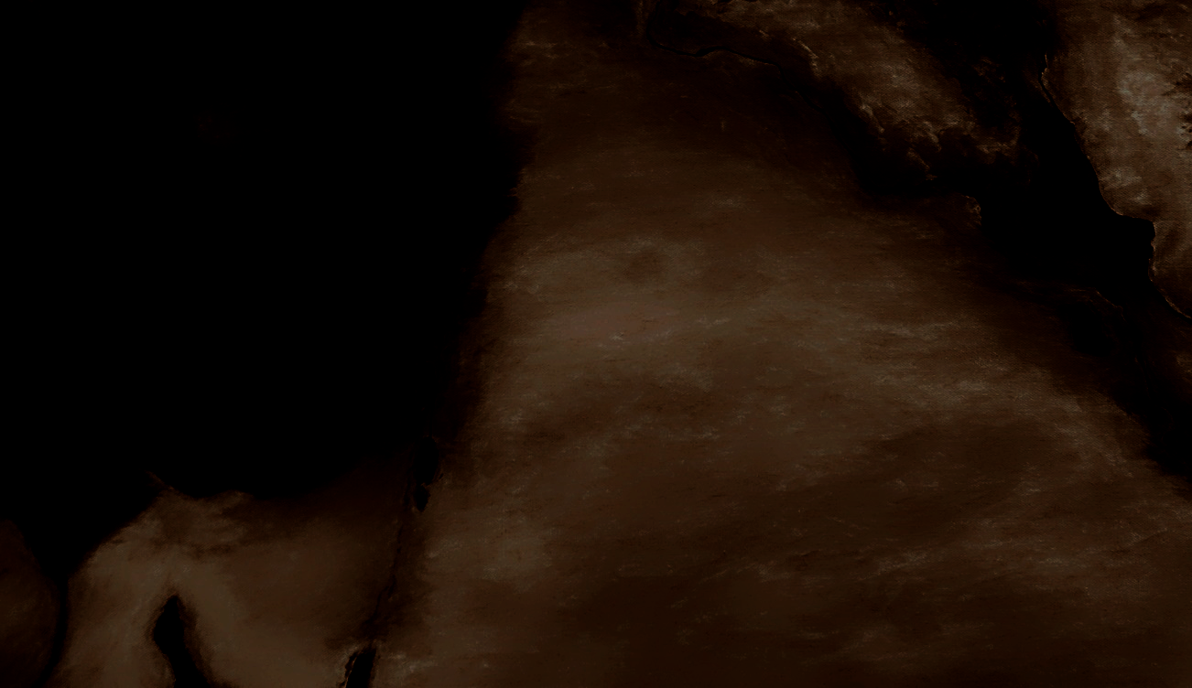
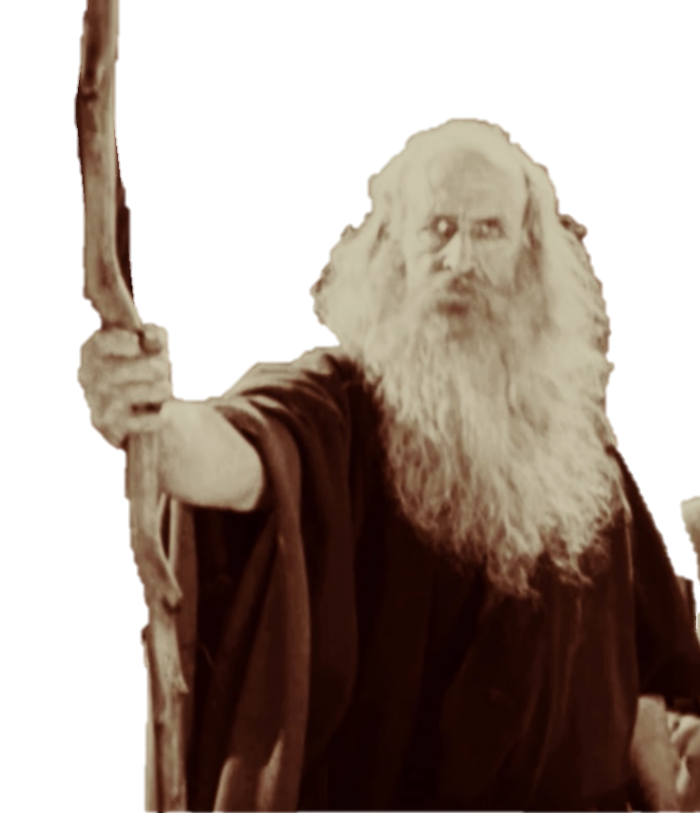
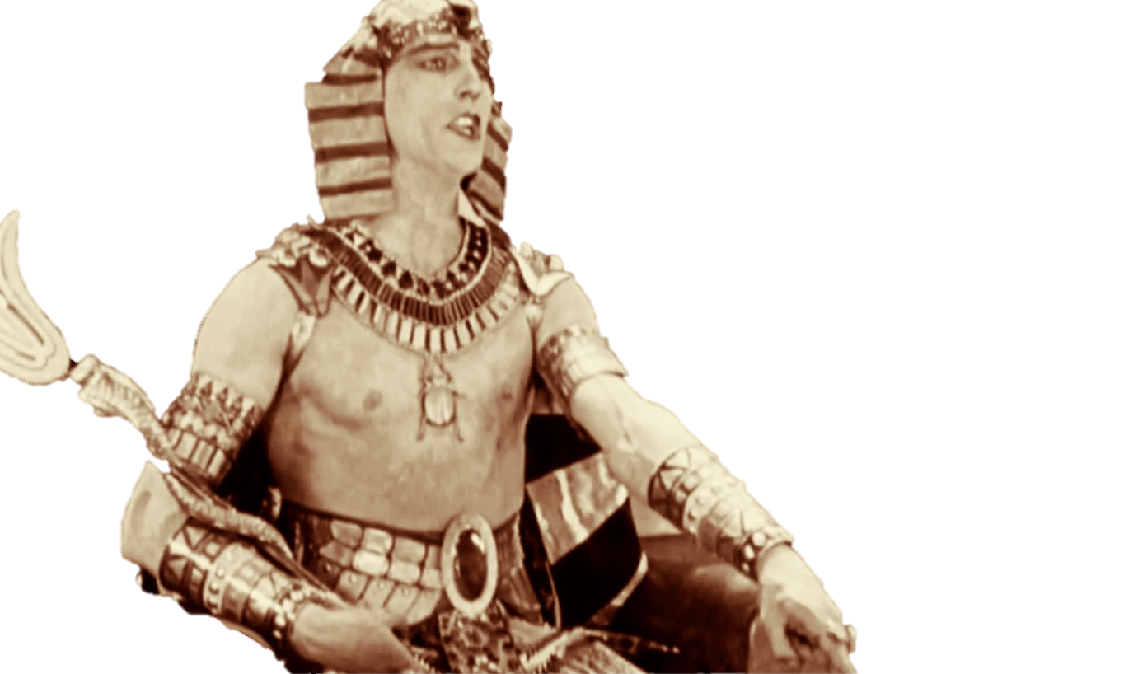


FATHER’S TIMELINE
GENERATIONS
of the world
EPISODE 4 - LOST SHEEP: A HISTORY OF ANCIENT ISRAEL

Slide 2
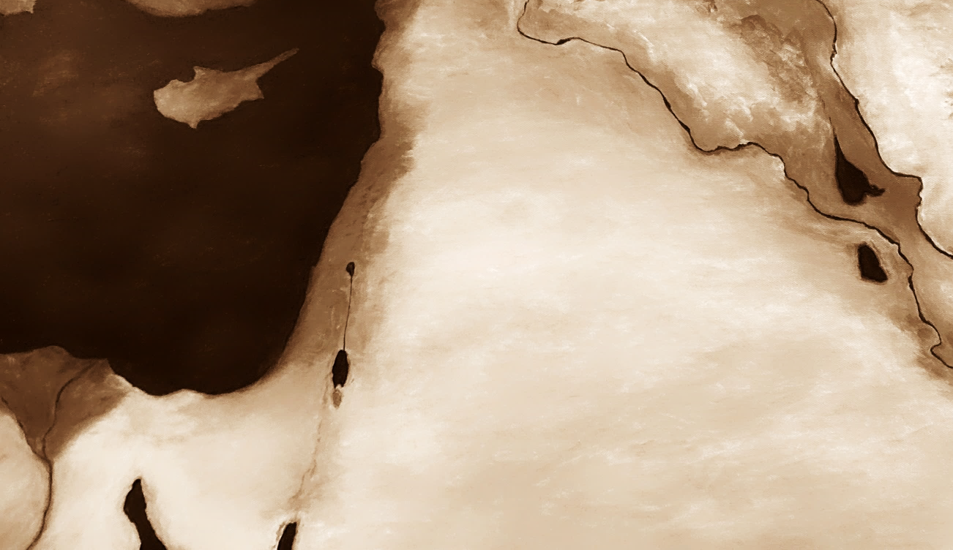

This presentation is available as a free download from fathersalphabet.com. It includes only original artwork and materials believed to be in the public domain. We waive all copyrights for any original work created by us. However, please note that we cannot waive or transfer any rights belonging to third parties.

Slide 3
sojourn of the sons of israel
Jacob is given the name Israel as he and his sons travelled to Canaan
“Now the sojourning of the children of Israel, who dwelt in Egypt, was 430 years.”
Exodus 12:40
30 years in Canaan
400 years in Egypt
Exodus
our view
Free downloads at fathersalphabet.com/timeline

Slide 4
sojourn of the sons of israel
Jacob is given the name Israel as he and his sons travelled to Canaan
“Now the sojourning of the children of Israel, who dwelt in Egypt, was 430 years.”
Exodus 12:40
30 years in Canaan
400 years in Egypt
Exodus
our view
Jacob (Israel) is born
Exodus
215 Year
view
215 years in Canaan
215 years in Egypt

Slide 5
400 YEARS IN EGYPT
“And HE said unto Abram,
Know of a surety that thy seed shall be a stranger in a land that is not theirs, and shall serve them; and they shall afflict them 400 years; And also that nation, whom they shall serve will I judge: and afterward shall they come out with great substance.”
- Genesis 15

Slide 6
400 YEARS IN EGYPT
“And HE said unto Abram,
Know of a surety that thy seed shall be a stranger in a land that is not theirs, and shall serve them (root word: abad); and they shall afflict them 400 years; And also that nation, whom they shall serve (root word: abad), will I judge: and afterward shall they come out with great substance.”
- Genesis 15
Note: Some say this prophecy is about Egypt and Canaan, but it speaks of one land and one nation. Canaan is one land, but according to the Scriptures it was home to many nations (Canaanites, Hittites, Hivites, Perizzites, Girgashites, Amorites and Jebusites).

Slide 7
400 YEARS IN EGYPT
“And HE said unto Abram,
Know of a surety that thy seed shall be a stranger in a land that is not theirs, and shall serve them (root word: abad); and they shall afflict them 400 years; And also that nation, whom they shall serve (root word: abad), will I judge: and afterward shall they come out with great substance.”
And thou shalt go to thy fathers in peace; thou shalt be buried in a good old age. But in the fourth generation they shall come hither again: for the iniquity of the Amorites is not yet full.”
- Genesis 15

Slide 8
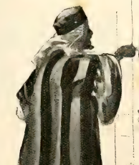
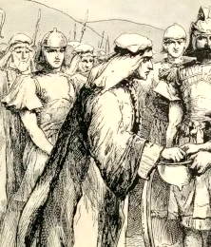
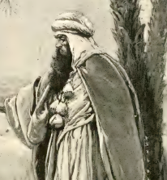
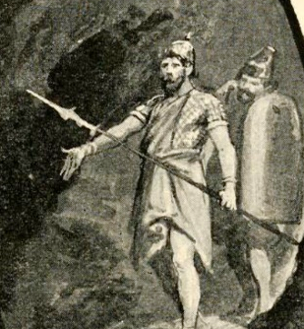

400 YEARS IN EGYPT
“But in the fourth generation they shall come hither again”
generations in the line of messiah
1
2
3
4
Ram was the 1st generation born after all Israel went to Egypt in 1892BC.
Amminadab was the
2nd generation born after Israel went to Egypt.
Nahshon was the 3rd generation born after Israel went to Egypt; he was a leader at the time of the Exodus in 1493BC.
Salmon was the 4th generation born after Israel went to Egypt; he entered The Land with Joshua.

Slide 9
400 YEARS IN EGYPT
“And [Joseph] took some of his brethren, even five men, and presented them unto Pharaoh. And Pharaoh said unto his brethren, What is your occupation? And they said unto Pharaoh, Thy servants (root word: abad) are shepherds, both we, and also our fathers.”
- Genesis 47:3

Slide 10
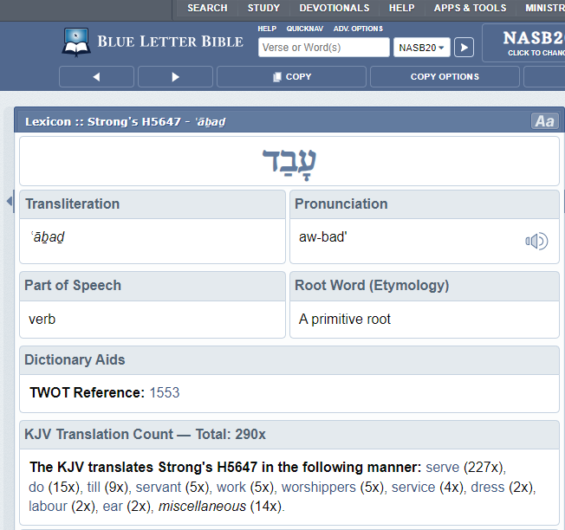
“abad”
Most commonly translated
as “to serve”
עבד
dalet
(d)
bet
(b)
ayin
(a)

Slide 11
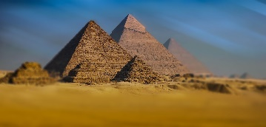
aligning the Ancient Egyptian timeline with the bible
1st cities, hieroglyphs
First dark ages
Giza Pyramids
EGYPTian
history
369 years
1020 years
The Flood 2532 BC
Exodus
End of Joseph’s famine
biblical
history
394 years
1042 years

Slide 12
Egypt’s first dark ages (“First Intermediate Period”)
collapse of the central government
extreme poverty
large state projects cancelled
few royal inscriptions
many independent kingdoms
the Ipuwer Papyrus is traditionally dated to this time period. It describes the waters being blood, empty storehouses, the land lying waste, and lawlessness
quotes from local leaders of the time:
  "All of upper Egypt were dying of hunger and people were eating their children, but I did not allow anybody to die of hunger in this nome (province)" - Anktify
  "I nourished [my province] in years of misery" - Iti of Imyotru

Slide 13
GREATER EXODUS
“Therefore, behold, the days come, saith THE LORD, that it shall no more be said, THE LORD liveth, that brought up the children of Israel out of the land of Egypt; But, THE LORD liveth, that brought up the children of Israel from the land of the north, and from all the lands whither he had driven them.”
- Jeremiah 16:14-15

Slide 14
Enoch’s Parable of the Animals
1 Enoch, Chapters 89-90
And when those twelve sheep had grown, they gave up one of them to the asses, and those asses again gave up that sheep to the wolves, and that sheep grew up among the wolves.
And the Lord brought the eleven sheep to live with it and to pasture with it among the wolves: and they multiplied and became many flocks of sheep.
1913bc
Joseph is sold into slavery
1892bc
All Israel goes to Egypt

Slide 15
Enoch’s Parable of the Animals
1 Enoch, Chapters 89-90
And the wolves began to fear them, and they oppressed them until they destroyed their little ones, and they cast their young into a river of much water: but those sheep began to cry aloud on account of their little ones, and to complain unto their Lord.
And a sheep which had been saved from the wolves fled and escaped to the wild asses; and I saw the sheep how they lamented and cried, and besought their Lord with all their might, till that Lord of the sheep descended at the voice of the sheep from a lofty abode, and came to them and pastured them.
Pharoah kills the Israelite babies
Moses flees to Midian

Slide 16
Enoch’s Parable of the Animals
1 Enoch, Chapters 89-90
And He called that sheep which had escaped the wolves, and spake with it concerning the wolves that it should admonish them not to touch the sheep.
And the sheep went to the wolves according to the word of the Lord, and another sheep met it and went with it, and the two went and entered together into the assembly of those wolves, and spake with them and admonished them not to touch the sheep from henceforth.
GOD appears to Moses at the burning bush
Aaron meets Moses and they speak with Pharaoh

Slide 17
Enoch’s Parable of the Animals
1 Enoch, Chapters 89-90
And thereupon I saw the wolves, and how they oppressed the sheep exceedingly with all their power; and the sheep cried aloud.
And the Lord came to the sheep and they began to smite those wolves: and the wolves began to make lamentation; but the sheep became quiet and forthwith ceased to cry out.
Pharoah oppresses the Israelites
The plagues begin

Slide 18
Enoch’s Parable of the Animals
1 Enoch, Chapters 89-90
And I saw the sheep till they departed from amongst the wolves; but the eyes of the wolves were blinded, and those wolves departed in pursuit of the sheep with all their power.
And the Lord of the sheep went with them, as their leader, and all His sheep followed Him:
and his face was dazzling and glorious and terrible to behold.
But the wolves began to pursue those sheep till they reached a sea of water.
1493bc
The Exodus

Slide 19
Enoch’s Parable of the Animals
1 Enoch, Chapters 89-90
And that sea was divided, and the water stood on this side and on that before their face, and their Lord led them and placed Himself between them and the wolves.
And as those wolves did not yet see the sheep, they proceeded into the midst of that sea, and the wolves followed the sheep, and [those wolves] ran after them into that sea.
GOD parts the Red Sea

Slide 20
Enoch’s Parable of the Animals
1 Enoch, Chapters 89-90
And when they saw the Lord of the sheep, they turned to flee before His face, but that sea gathered itself together, and became as it had been created, and the water swelled and rose till it covered those wolves.
And I saw till all the wolves who pursued those sheep perished and were drowned.
Pharaoh and all his army perish in the Sea

Slide 21
Enoch’s Parable of the Animals
1 Enoch, Chapters 89-90
But the sheep escaped from that water and went forth into a wilderness, where there was no water and no grass; and they began to open their eyes and to see; and I saw the Lord of the sheep pasturing them and giving them water and grass, and that sheep going and leading them.
And that sheep ascended to the summit of that lofty rock, and the Lord of the sheep sent it to them.
Israel in the wilderness

Slide 22
Enoch’s Parable of the Animals
1 Enoch, Chapters 89-90
And after that I saw the Lord of the sheep who stood before them, and His appearance was great and terrible and majestic, and all those sheep saw Him and were afraid before His face.
And they all feared and trembled because of Him, and they cried to that sheep with them
[which was amongst them]: "We are not able to stand before our Lord or to behold Him."
Israel in the wilderness

Slide 23
Enoch’s Parable of the Animals
1 Enoch, Chapters 89-90
And that sheep which led them again ascended to the summit of that rock, but the sheep began to be blinded and to wander from the way which he had showed them, but that sheep wot not thereof.
And the Lord of the sheep was wrathful exceedingly against them, and that sheep discovered it, and went down from the summit of the rock, and came to the sheep, and found the greatest part of them blinded and fallen away.
Israel worships the golden calf

Slide 24
Enoch’s Parable of the Animals
1 Enoch, Chapters 89-90
And when they saw it they feared and trembled at its presence, and desired to return to their folds.
And that sheep took other sheep with it, and came to those sheep which had fallen away, and began to slay them; and the sheep feared its presence, and thus that sheep brought back those sheep that had fallen away, and they returned to their folds.

Slide 25
Enoch’s Parable of the Animals
1 Enoch, Chapters 89-90
And I saw in this vision till that sheep became a man and built a house for the Lord of the sheep, and placed all the sheep in that house.
And I saw till this sheep which had met that sheep which led them fell asleep: and I saw till all the great sheep perished and little ones arose in their place, and they came to a pasture, and approached a stream of water.
Moses constructs the Tabernacle
Israel comes to the Jordan river

Slide 26
Enoch’s Parable of the Animals
1 Enoch, Chapters 89-90
And I saw till the sheep came to a goodly place, and a pleasant and glorious land, and I saw till those sheep were satisfied; and that house stood amongst them in the pleasant land.
And sometimes their eyes were opened, and sometimes blinded, till another sheep arose and led them and brought them all back, and their eyes were opened.
1453bc
Israel conquers Canaan
The time of the Judges

Slide 27
Enoch’s Parable of the Animals
1 Enoch, Chapters 89-90
And the dogs and the foxes and the wild boars began to devour those sheep till the Lord of the sheep raised up [another sheep] a ram from their midst, which led them.
And that ram began to butt on either side those dogs, foxes, and wild boars till he had destroyed them †all†.
And that sheep whose eyes were opened saw that ram, which was amongst the sheep, till it †forsook its glory† and began to butt those sheep, and trampled upon them, and behaved itself unseemly.
1099bc
Saul becomes King of Israel

Slide 28
Enoch’s Parable of the Animals
1 Enoch, Chapters 89-90
And the Lord of the sheep sent the lamb to another lamb and raised it to being a ram and leader of the sheep instead of that ram which had †forsaken its glory†.
And it went to it and spake to it alone, and raised it to being a ram, and made it the prince and leader of the sheep; but during all these things those dogs oppressed the sheep.
Samuel anoints David

Slide 29
Enoch’s Parable of the Animals
1 Enoch, Chapters 89-90
And the first ram pursued that second ram, and that second ram arose and fled before it;
and I saw till those dogs pulled down the first ram. And that second ram arose and led the [little] sheep.
And those sheep grew and multiplied; but all the dogs, and foxes, and wild boars feared and fled before it, and that ram butted and killed the wild beasts, and those wild beasts had no longer any power among the sheep and robbed them no more of ought.
Saul pursues David
1059bc
David reigns as King of Israel

Slide 30
Enoch’s Parable of the Animals
1 Enoch, Chapters 89-90
And that ram begat many sheep and fell asleep; and a little sheep became ram in its stead, and became prince and leader of those sheep.
And that house became great and broad, and it was built for those sheep: (and) a tower lofty and great was built on the house for the Lord of the sheep, and that house was low, but the tower was elevated and lofty, and the Lord of the sheep stood on that tower and they offered a full table before Him.
1019bc
Solomon becomes King of Israel
Solomon builds a House (Temple) for Father

Slide 31
Enoch’s Parable of the Animals
1 Enoch, Chapters 89-90
And again I saw those sheep that they again erred and went many ways, and forsook that their house, and the Lord of the sheep called some from amongst the sheep and sent them to the sheep, but the sheep began to slay them.
And one of them was saved and was not slain, and it sped away and cried aloud over the sheep; and they sought to slay it, but the Lord of the sheep saved it from the sheep, and brought it up to me, and caused it to dwell there.
GOD sends prophets and Israel slays them
Elijah prophesies and is taken up

Slide 32
Enoch’s Parable of the Animals
1 Enoch, Chapters 89-90
And many other sheep He sent to those sheep to testify unto them and lament over them.
GOD sends more prophets to Israel

Slide 33
Enoch’s Parable of the Animals
1 Enoch, Chapters 89-90
And after that I saw that when they forsook the house of the Lord and His tower they fell away entirely, and their eyes were blinded; and I saw the Lord of the sheep how He wrought much slaughter amongst them in their herds until those sheep invited that slaughter and betrayed His place.
And He gave them over into the hands of the lions and tigers, and wolves and hyenas, and into the hand of the foxes, and to all the wild beasts, and those wild beasts began to tear in pieces those sheep.
Judgment on Israel; the scattering of the tribes begins

Slide 34
Enoch’s Parable of the Animals
1 Enoch, Chapters 89-90
And I saw that He forsook that their house and their tower and gave them all into the hand of the lions, to tear and devour them, into the hand of all the wild beasts.
And I began to cry aloud with all my power, and to appeal to the Lord of the sheep, and to represent to Him in regard to the sheep that they were devoured by all the wild beasts.
But He remained unmoved, though He saw it, and rejoiced that they were devoured and swallowed and robbed, and left them to be devoured in the hand of all the beasts.
Judgment on Israel; the scattering of the tribes begins

Slide 35
Enoch’s Parable of the Animals
1 Enoch, Chapters 89-90
And the lions and tigers eat and devoured the greater part of those sheep, and the wild boars eat along with them; and they burnt that tower and demolished that house.
588bc
The scattering of Israel is complete when the Babylonians destroy the House (Temple) and take Judah into exile

Slide 36
Enoch’s Parable of the Animals
1 Enoch, Chapters 89-90
And forthwith I saw how the shepherds pastured for twelve hours, and behold three of those sheep turned back and came and entered and began to build up all that had fallen down of that house; but the wild boars tried to hinder them, but they were not able.
And they began again to build as before, and they reared up that tower, and it was named the high tower; and they began again to place a table before the tower, but all the bread on it was polluted and not pure.
The House of Judah returns to the land with Zerubbabel

Slide 37
Enoch’s Parable of the Animals
1 Enoch, Chapters 89-90
And as touching all this the eyes of those sheep were blinded so that they saw not, and (the eyes of) their shepherds likewise; and they delivered them in large numbers to their shepherds for destruction, and they trampled the sheep with their feet and devoured them.
And the Lord of the sheep remained unmoved till all the sheep were dispersed over the field and mingled with them (i.e. the beasts), and they (i.e. the shepherds) did not save them out of the hand of the beasts.

Slide 38
israel’s 390 Years of iniquity
After Solomon, the books of Kings and Chronicles record 393 years of kings reigning in Jerusalem.
“And after them out of all the tribes of Israel such as set their hearts to seek the LORD GOD of Israel came to Jerusalem, to sacrifice unto the LORD GOD of their fathers. So they strengthened the kingdom of Judah, and made Rehoboam the son of Solomon strong, 3 years: for 3 years they walked in the way of David and Solomon.
…And it came to pass, when Rehoboam had established the kingdom, and had strengthened himself, he forsook the law of the LORD, and all Israel with him.”
- From 2 Chronicles 11:16-12:1
The Temple is destroyed; Judah is taken into exile
Rehoboam becomes King of Judah
3 years of following YHVH
390 years of iniquity
“For I have laid upon thee the years of their iniquity, according to the number of the days, 390 days: so shalt thou bear the iniquity of the house of Israel.” – Ezekiel 4:5

Slide 39
israel’s 390 Years of iniquity
All Israel forsook YHVH after 3 years of Rehoboam’s reign
Father destroys the House (Temple) all israel built for Him
390 years
JUDAH’s 40 Years of iniquity
Judah does not listen to YASHUA at the start of His ministry
Father destroys the House (Temple) Judah built for Him
40 years

Slide 40
israel’s 390 Year punishment
Samaria is conquered by the Assyrians (721 BC)
721 BC
332 BC
2001 AD
390 years
390 x 7 years (2730 years)
390 x 7 x 7 years → → →
All years are in 364 day years. Free Biblical history and Bible prophecy timeline at fathersalphabet.com/timeline

Slide 41
Judah’s 40 Year punishment
Jerusalem is conquered by the Romans (c. 70 AD)
110 AD
2024 AD
70 AD
349 AD
40 years
40 x 7 years (280 years)
40 x 7 x 7 years (1960 years)
40 x 7 x 7 x 7 years → → →

Slide 42
Many Scriptures speak of the scattering of Israel
to all nations. here are just a few:
“And the LORD shall scatter thee among all people, from the one end of the earth even unto the other” Deuteronomy 28:64
“For, lo, I will command, and I will sift the house of Israel among all nations, like as corn is sifted in a sieve, yet shall not the least grain fall upon the earth” Amos 9:9
“And I scattered them among the heathen, and they were dispersed through the countries: according to their way and according to their doings I judged them” Ezekiel 36:19

Slide 43
From over a million fighting men in all Israel in David’s time…
“And Joab gave up the sum of the number of the people unto the king: and there were in Israel 800,000 valiant men that drew the sword; and the men of Judah were 500,000 men.” – 2 Samuel 24
…to less than 5,000 inhabitants of Jerusalem at its conquest.
“This is the people whom Nebuchadrezzar carried away captive: in the 17th year 3023 Jews: In the 18th year of Nebuchadrezzar he carried away captive from Jerusalem 832 persons: In the 23rd year of Nebuchadrezzar Nebuzaradan the captain of the guard carried away captive of the Jews 745: all the persons were 4600.” – Jeremiah 52

Slide 44
To the lost sheep of the House of Israel
“For thus saith THE LORD GOD; Behold, I, even I, will both search My sheep, and seek them out. As a shepherd seeketh out his flock in the day that he is among his sheep that are scattered; so will I seek out My sheep, and will deliver them out of all places where they have been scattered in the cloudy and dark day.
And I will bring them out from the people, and gather them from the countries, and will bring them to their own land, and feed them upon the mountains of Israel by the rivers, and in all the inhabited places of the country.
I will feed them in a good pasture, and upon the high mountains of Israel shall their fold be: there shall they lie in a good fold, and in a fat pasture shall they feed upon the mountains of Israel. I will feed my flock, and I will cause them to lie down, saith the Lord GOD.
I will seek that which was lost, and bring again that which was driven away”
- Ezekiel 34

